Slide 1
Productivity Prediction of Garment Employees

Slide 2
Description of the dataset
The Garment Industry is one example of the industrial globalization of the modern era. Characterized by its labor-intensive nature and dependency on manual processes, the industry’s success depends on the efficiency and performance of its employees. This dataset provides key attributes that will give us insight into employee productivity and performance within the company.
Source: Productivity Prediction of Garment Employees - UCI Machine Learning Repository

Slide 3
Description of the dataset – Data type
Date : This column is the specific date of each entry, and it is considered as date type.
Day : This data is a categorical data type, and it is the day of the Week.
Quarter : This column is a portion of the month. A month was divided into four quarters. This data type is a string.
Department : This data is a string and is describing an associated department within the company.
Team_no : This is referring to the associated team number with the company. This column is an integer.
No_of_workers : This column is an integer and is the number of workers in each team.
No_of_style_change : Number of changes in the style of a particular product. This data type is an integer.
Targeted_productivity : Targeted productivity set by the team’s supervisor for each day. This is an integer.

Slide 4
Description of the dataset – Data type (cont.)
SMV : This column is a float data type, and it is referring to the standard Minute Value, it is the allocated time for a task.
WIP : Work in progress. Includes the number of unfinished items for products. This data type is an integer.
Over_time : Represents the amount of overtime by each team in minutes. This is an integer
Incentive : Represents the amount of financial incentive (in BDT) that enables or motivates a particular course of action. This is a float.
Idle_time : The amount of time when the production was interrupted due to several reasons. This is an integer.
Idle_men : The number of workers who were idle due to production interruption. This is an integer.
Actual_productivity : The actual % of productivity that was delivered by the workers. It ranges from 0-1. This is a float.

Slide 5
Problem statement
The Garment industry is facing challenges in maintaining high productivity and performance levels. The company is focused on identifying the key factors contributing to low productivity within the garment manufacturing teams and exploring effective strategies to address these issues. By analyzing this data, the company hopes to gain insights that will inform future strategies and business decisions to optimize performance and enhance operational efficiency.

Slide 6
MLS Flowchart
Data Extraction
Target:
- Actual productivity
Data Collection:
Data from Productivity Prediction of Garment Employees.
Data Preparation
Run the predictive model one hour before the start of a shift and one hour before the end of each shift.
SQL table
Data Processing
Model Training
Features:
- Department
- Team number
- Number of workers
- Number of style change
- Standard minute value
- Overtime
- Idle time
- Idle men
- Targeted productivity
Deployment
Monitor & Maintenance
Data Transformation
Maintenance once a week. If failure appears contact data engineering department.
Data Output

Slide 7
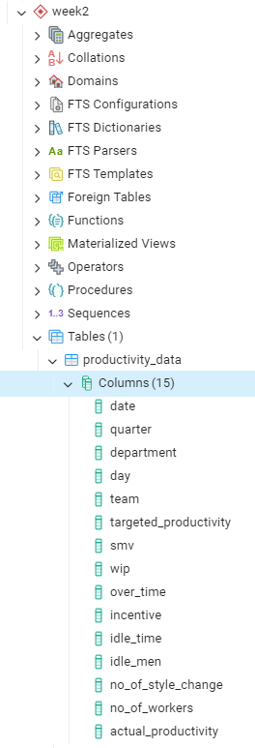
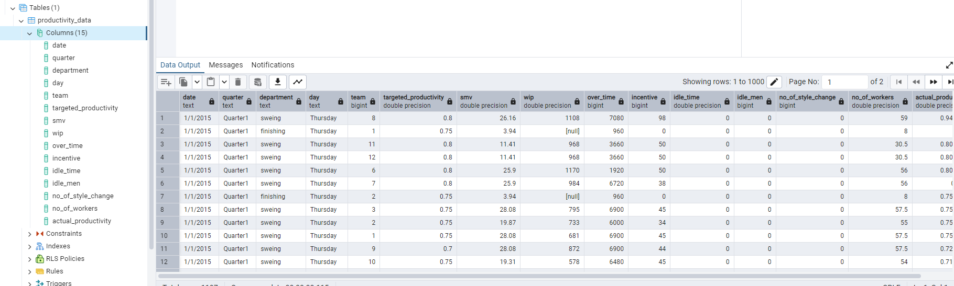
Loaded data in pgAdmin

Slide 8
Pipeline Design
Model Training and Evaluation
Data processing
Real-time analytics
Shift
Alerts
Data Ingestion
Logs
Excel
Storage
SQL
Model Training and Evaluation
Ignition
Data processing
Month 1
Business Intelligence
Month 2
Alerts
Month 3
Notes:
1. Diagram the Pipeline:
Data Ingestion for batch and streaming ingestion: The data will be ingested from excel workbooks, logs and ignition, then will be updated periodically with real-time production data.
Storage: The ingested, processed data, real time analytics and business intelligence as well as alerts will be store in SQL table.
Data processing for batch and streaming ingestion: The data will be cleaned, transformed, normalized, and feature engineering will be performed in Python. Then the results are stored in SQL table.
Modeling:
Batch model training: For modeling we will use Python. We will train the predictive models based on historical data and the results will be stored in SQL.
Streaming model training: For modeling we will use Python. Once the model is trained, the real-time predictions and results will be stored in SQL as new columns.
Data Analytics and visualization layer:
Batch analytics and visualization: We will create monthly reports where we will gain insight into productivity trends, overtime usage and provide cross team comparisons, we will save those as excel files.
Streaming analytics and visualization: After each shift we will have the results in an excel report, this will help in adjusting resources, focus areas and scheduling.
Alerts:
Batch alerts: Generate trends and visualizations with the 5 most recurrent alerts per month.
Streaming alerts: Periodic alerts through the shift and notifications.
2. Pipeline Type
The pipeline will be a combination of streaming and batch processing.
Real-time or Streaming: The goal is to continuously monitor the performance of the teams, using a model that runs one hour before the start of each shift. This will enable the capture of real-time, over-time, idle time, and productivity metrics. Therefore, we can make data-driven decisions and adjust schedules and resources to optimize shift performance and productivity.
Batch processing: Once a month, the company aims to analyze historical data to identify trends, patterns and correlations. This will give us an insight for adjustments and strategies.
3. Data Format
The data will be stored in an SQL table throughout the model, then reports will be saved in Excel. SQL tables were chosen as storage for its efficiency with large datasets. Excel was chosen for reports because it is user friendly and a quick way to communicate.

Slide 9
Data Quality
Quality issues
Plan
Missing values
Data drift
Categorical variables
Schema changes
Outliers
General changes
Notes:
Data Quality
Three quality issues in the dataset:
Missing values: Column WIP (Work in progress, Includes the number of unfinished items) presented 42% of missing values. It was decided to remove that column, 42% of missing data in the WIP column can significantly impact the analysis and modeling.
Categorical variables: The categorical variables from our dataset (department, day, quarter) were transformed to numerical values.
Outliers: We identified outliers in our database by using EDA (incentives, no_of_workers, over_time). This quality issue wasn’t addressed. We could have addressed this issue by applying transformation (if the data is skewed, we could consider transforming it), removing the rows (when outliers are an error), and/or clipping (if the outlier is real but it is out of the range of the dataset, we could consider clipping it.)
Monitoring quality in the pipeline:
Missing values: Monitoring if future data ingestions, processing or updates introduce additional missing values in critical columns. If the missing value pattern changes in WIP we will consider reintroducing it into the database. The validation and action in this specific column is removing it.
Categorical variables: We will create a script to monitor the introduction of new or unexpected categorical values in these columns. As well as set up checks to ensure that the categorical data remains consistent.
Outliers: After applying the method to handle outliers, we will monitor the overtime data to ensure that new outliers don’t continue to appear. We will ensure this by creating a script and will run periodically to check for outliers in the ingestion. Also, we will set a range with maximum and minimum values for alerts.
Plan to detect data drift or schema changes over time:
For data drift, we will monitor shifts in feature distributions, look for relationships between features and targets, and we will incorporate visualizations, automated alerts, and statistical tests.
For schema changes, we will detect and monitor schema changes with automated comparisons, alerts and controlling schemas.
For changes, we will implement an automated re-training or model adaptation in response to drift or schema changes.

Slide 10
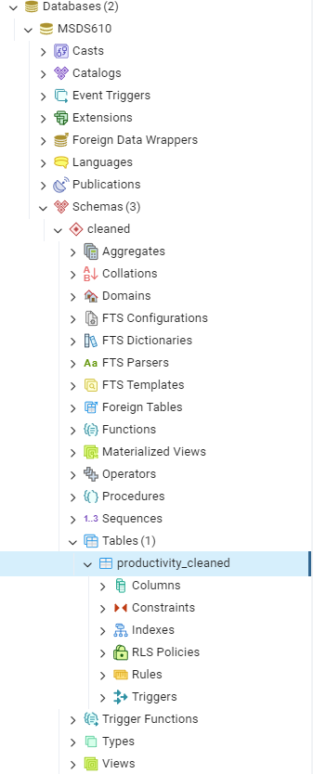
PostgeSQL Database Work

